Slide 1
Data Analysis using MySQL

Slide 2
INTRODUCTION
The project focuses on utilizing MySQL for analysis enabling the management of the company MovieOnRent to analyze what kind of movies are most often rented, which genres they belong to and which actors appeared in them. It will help the management stock up the inventory as per audience preferences for improved business.

Slide 3
Sakila Database
The Sakila database provides a rich and diverse dataset related to a fictional movie rental store. It includes information about movies, customers, rentals, and payments. This dataset allows for analysis of movie trends, customer behaviors, rental patterns, and financial aspects, providing valuable insights to support data-driven decision-making.

Slide 4
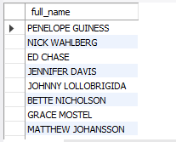
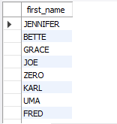
To obtain a comprehensive list of all available actors, I used the CONCAT function in SQL to retrieve and concatenate the first name and last name, resulting in the full names of the actors from the database.
To identify the count of actors with unique first names in the database, I utilized the COUNT() function along with the condition "COUNT = 1“

Slide 5
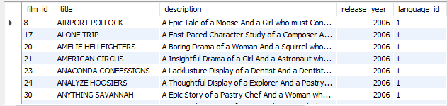
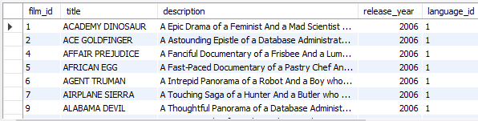
For getting the insights of movies with rating ‘R’ I used WHERE clause with the condition "rating = 'R'“ and hence got the record of movies with rating R
Also by employing the WHERE clause with the condition "rating = 'G' OR rating = 'PG', OR rating = 'PG-13‘ I identified movies suitable for audiences below 13 years of age.

Slide 6
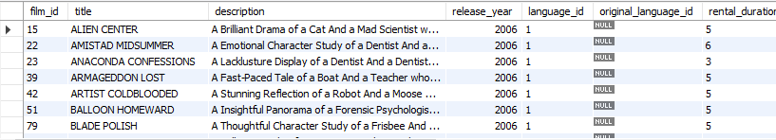
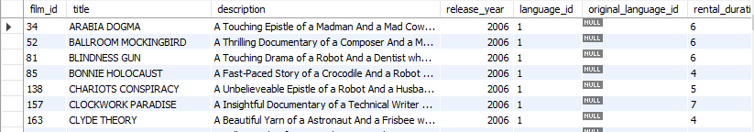
The board members wanted to understand the replacement cost of a movie copy. For that I used WHERE clause along with condition replacement_cost <=11 for identifing lower-cost movies that can be offered as budget-friendly options.
Also by employing the ORDER BY clause with the "replacement_cost" column in descending order, I retrieved a list of records for all movies sorted based on their replacement cost.

Slide 7
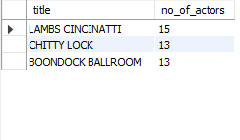
To find the top 3 movies with greatest number of actors I combined two tables "film" and "film_actor“ using join clause and using count function I got the total number of actors in each movie.
By sorting the results in descending order based on the actor count using the ORDER BY clause, I obtained a list of movies with the highest number of actors at the top at limited it by 3.

Slide 8
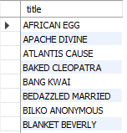
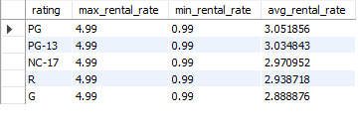
To find movies categorized as family film I used where clause for filtering Family category movies.
To find Maximum, Minimum, and Average rental rates of movies based on their ratings I used max, min and avg aggregate functions on rental rate and grouped it by rating.

Slide 9
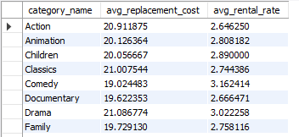
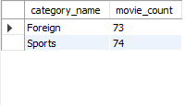
Management wanted to know the count of film categories in which the difference between avg film rental cost and avg film rental rate is greater than 15 so I used the group by and having clause to find the difference.
To find film categories in which number of movies is greater than 70 I used count function

Slide 10
CONCLUSION
In summary, the data analysis using SQL helped to understand what movies customers prefer and which movies are most popular due to their large ensemble casts. This knowledge enables us to offer a well selection of movies that appeals to the customers and contributes to the overall success of MovieOnRent.

Slide 11
THANKYOU

